Slide 1


OCTOBER 20 CLUB MEETING
Rotary Club of Blue Bell
Speaker: David Ivory, MCCC Director of Sound Recording and Music Technology

Slide 2
Today’s Agenda
7:30 AM
Introduction
Welcome • Introduce Guests • Pledge of Allegiance • Four-Way Test
7:40 AM
President’s Announcements
Upcoming Events • All Other Business Happy Dollars
8:00 AM
7:50*AM
Presentation
David Ivory, Director of MCCC SRT---Muscle Shoals Recording Residency
8:05 AM
8:30 AM
Closing • 8:30 Clean-Up / Departure
Wrap-up and reminders
8:25 AM
2

Slide 3

Welcome!
Good Morning, Blue Bell Rotarians!
Today: remember the impact we create — and the work that makes it possible.
Any guests today?
3

Slide 4
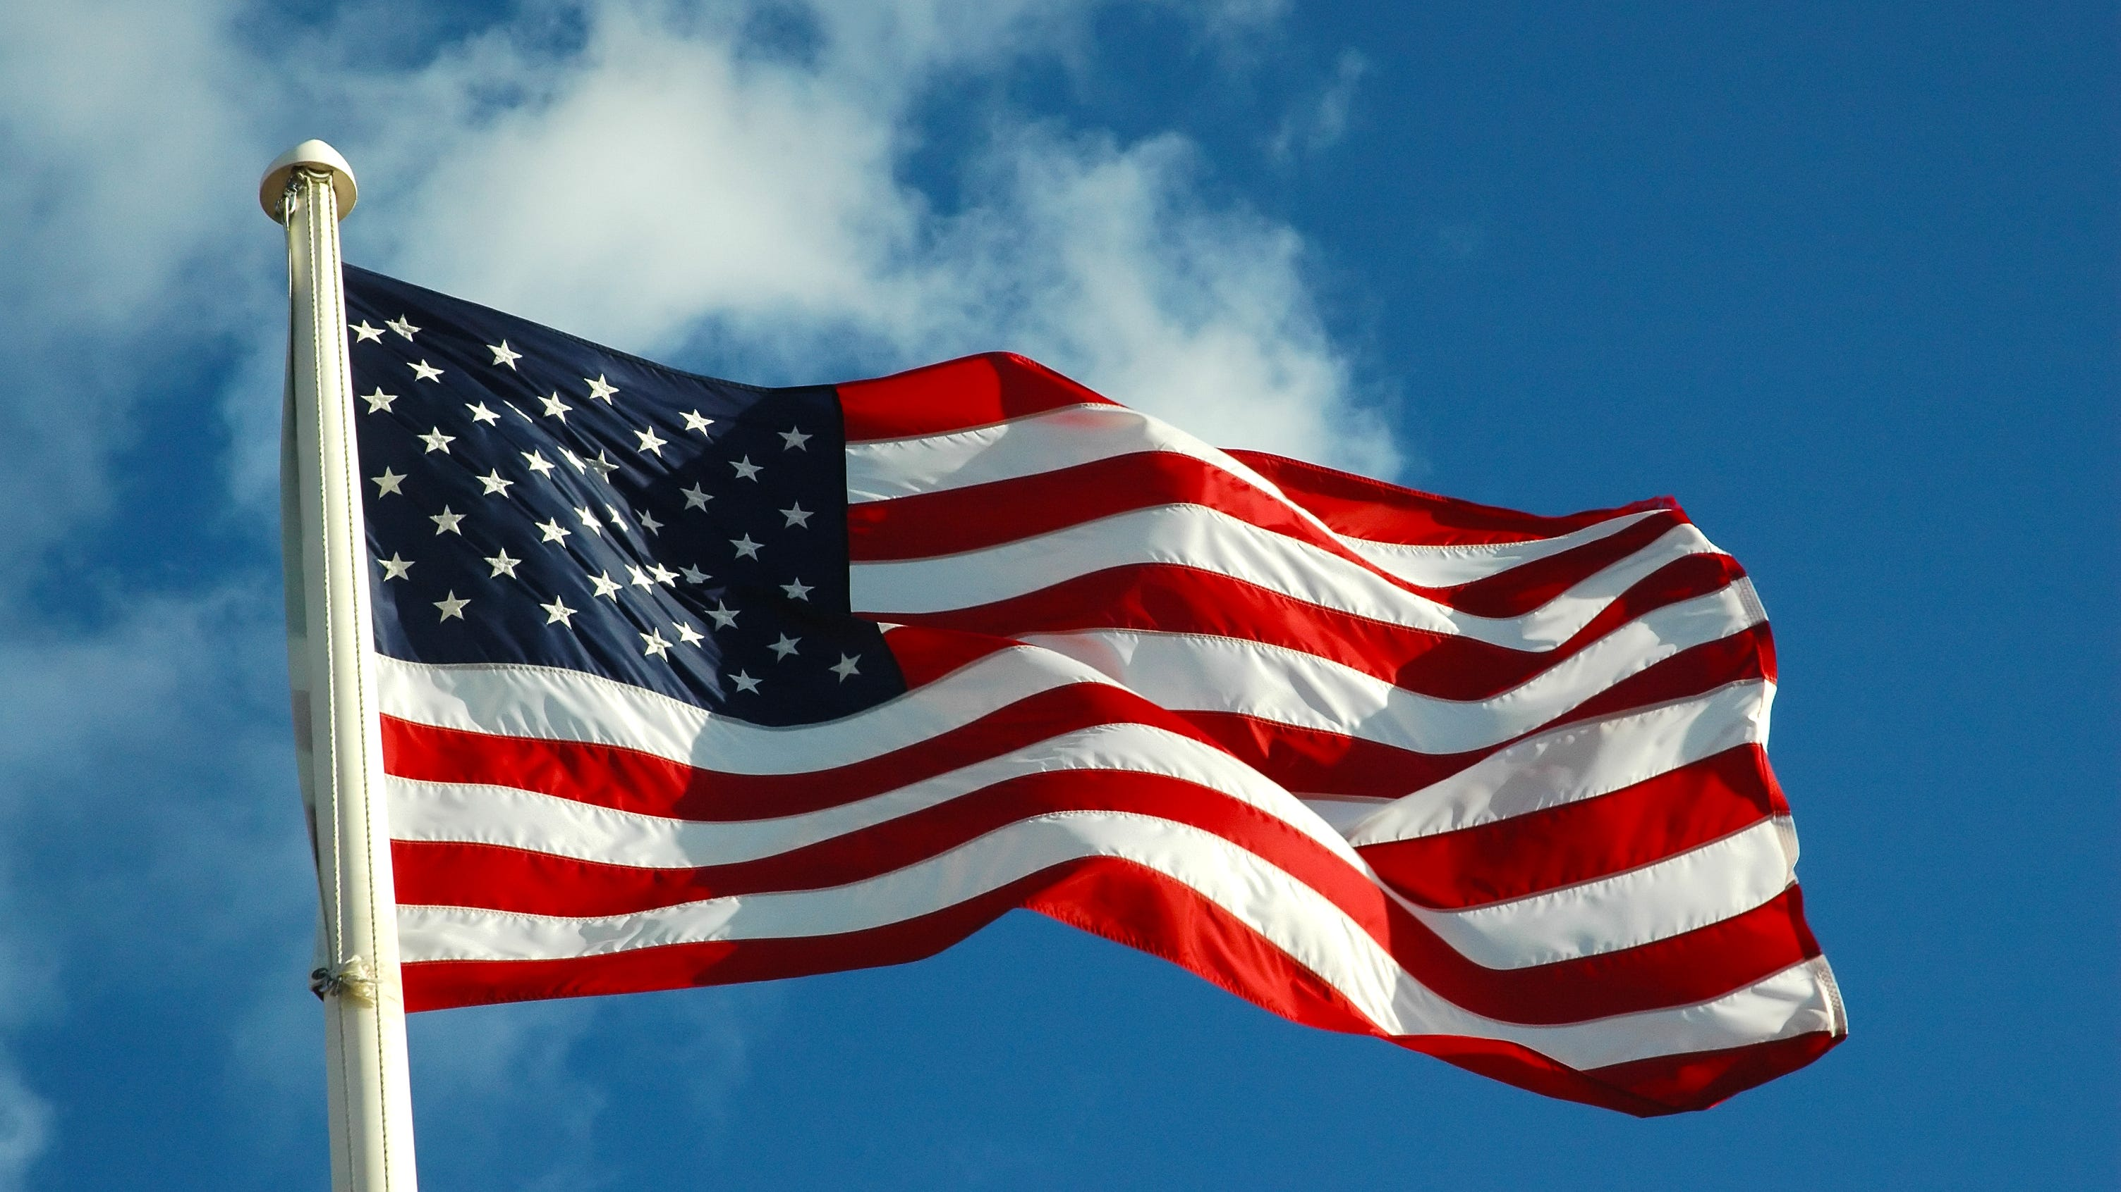
Pledge of Allegiance
“I pledge allegiance to the Flag of the United States of America,
and to the Republic for which it stands, one Nation under God,
indivisible, with liberty and justice for all.”
3
Notes:
Lead the pledge. Everyone stands.

Slide 5
The Four-Way Test
Of the things we think, say or do...
Is it the TRUTH?
1
Is it FAIR to all concerned?
2
•
Will it build GOODWILL and BETTER FRIENDSHIPS?
3
Will it be BENEFICIAL to all concerned?
4
5

Slide 6


Slide 7
Coming up!
Mark your calendars and join the fun
🍻
🏃
NEXT TUESDAY
OCTOBER 31
Social at Firebirds
Do Better4Steve Fearless 5K
Join us for good food and great company!
Lace up and run with Rotary!
Rotary Club of Blue Bell

Slide 8

Happy Dollars 💵
What’s making you happy this week?
7
Notes:
Hard stop at 7:45. Transition: 'And now — the reason we do all of this.'

