Slide 1


OCTOBER 6 CLUB MEETING
Rotary Club of Blue Bell
New Member Induction—Maureen King
Angelo, Blue Bell Horizons Update
Al Zone, Executive Director and CEO, Elmwood Park Zoo

Slide 2
Today’s Agenda
7:30 AM
Introduction
Welcome • Introduce Guests • Pledge of Allegiance • Four-Way Test
7:40 AM
President’s Announcements
Upcoming Events • Birthdays and Anniversaries • New Member Induction • Happy Dollars
8:00 AM
7:50*AM
Presentations
Angelo---brief update on recent Blue Bell Horizons event
Al Zone, President, Elmwood Park Zoo
8:05 AM
8:30 AM
Closing • 8:30 Clean-Up / Departure
Wrap-up and reminders
8:25 AM
2

Slide 3

Welcome!
Good Morning, Blue Bell Rotarians!
Today: remember the impact we create — and the work that makes it possible.
Any guests today?
3

Slide 4

Pledge of Allegiance
“I pledge allegiance to the Flag of the United States of America,
and to the Republic for which it stands, one Nation under God,
indivisible, with liberty and justice for all.”
3
Notes:
Lead the pledge. Everyone stands.

Slide 5
The Four-Way Test
Of the things we think, say or do...
Is it the TRUTH?
1
Is it FAIR to all concerned?
2
•
Will it build GOODWILL and BETTER FRIENDSHIPS?
3
Will it be BENEFICIAL to all concerned?
4
5

Slide 6


Slide 7
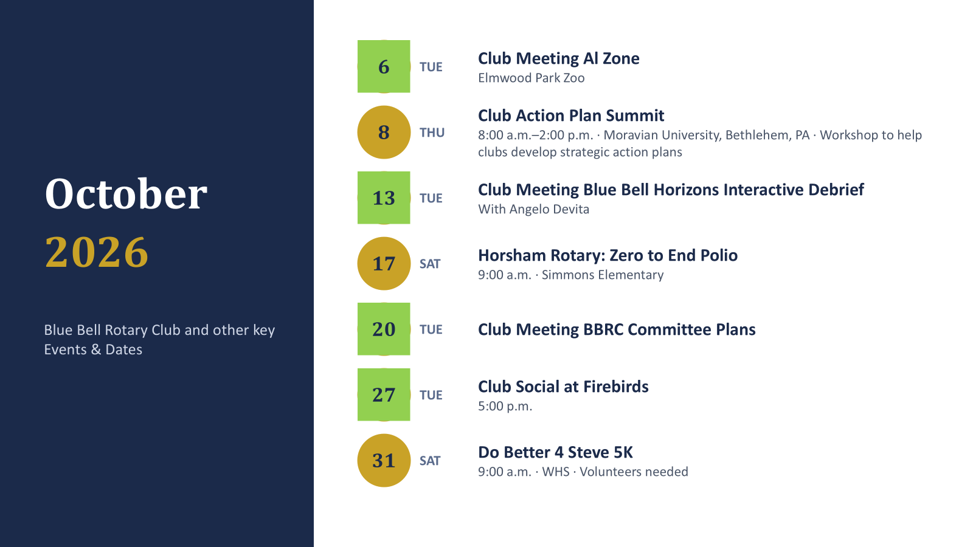
Upcoming District / Club Events
15

Slide 8
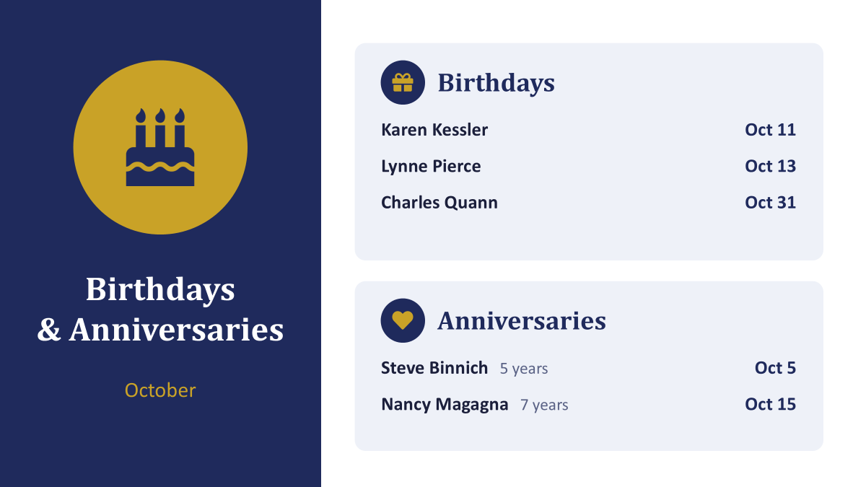
Birthdays and Anniversaries
1
2
•
5

Slide 9
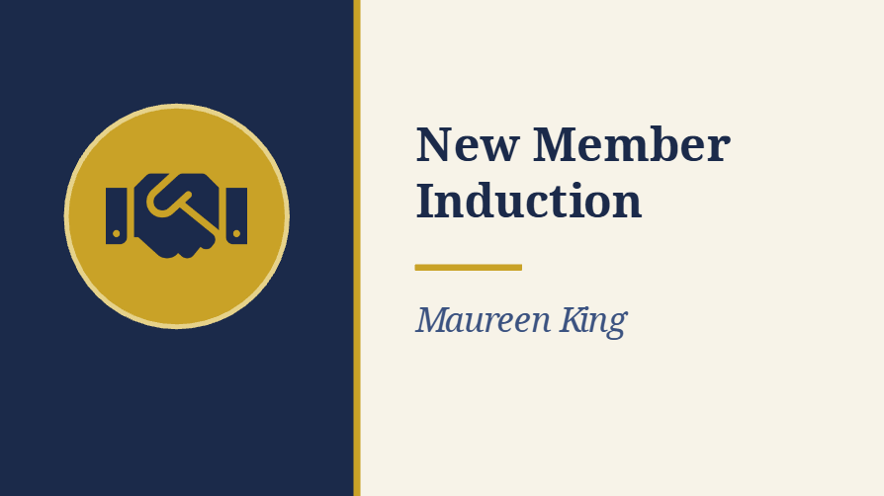
3

Slide 10

Happy Dollars 💵
What’s making you happy this week?
7
Notes:
Hard stop at 7:45. Transition: 'And now — the reason we do all of this.'

Slide 11
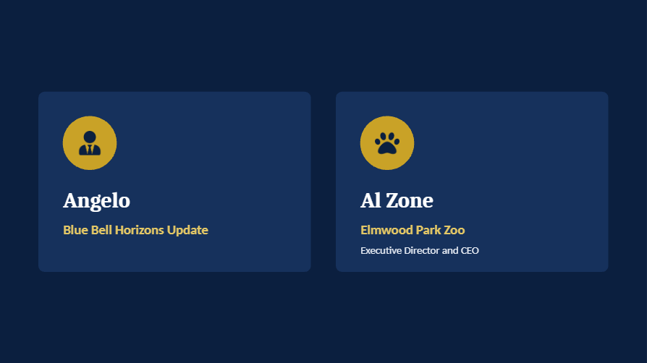
Todays Presenters
3

