Slide 1


SEPTEMBER 15 CLUB MEETING
Rotary Club of Blue Bell

Slide 2
Today’s Agenda
7:30 AM
Introduction
Welcome • Introduce Guests • Pledge of Allegiance • Four-Way Test
7:40 AM
President’s Announcements
Upcoming Events • Happy Dollars
8:00 AM
7:50*AM
Presentation
Blue Bell Horizons
8:05 AM
8:30 AM
Closing • 8:30 Clean-Up / Departure
Wrap-up and reminders
8:25 AM
2

Slide 3

Welcome!
Good Morning, Blue Bell Rotarians!
Today: the impact we create — and the work that makes it possible.
Any guests today?
3

Slide 4
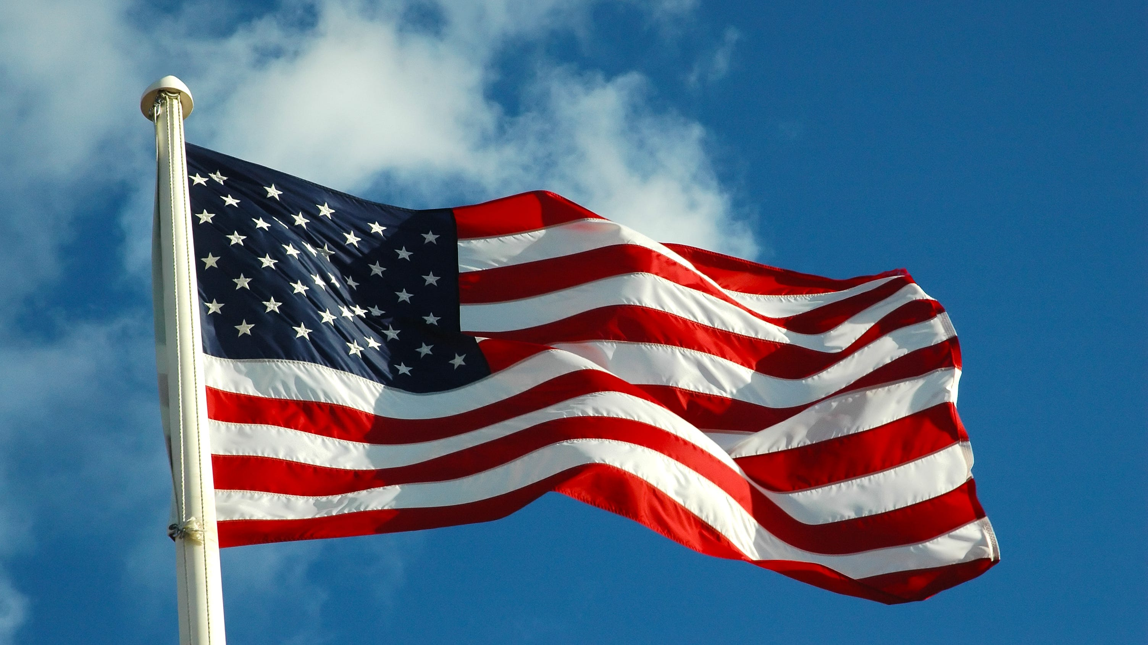
Pledge of Allegiance
“I pledge allegiance to the Flag of the United States of America,
and to the Republic for which it stands, one Nation under God,
indivisible, with liberty and justice for all.”
3
Notes:
Lead the pledge. Everyone stands.

Slide 5
The Four-Way Test
Of the things we think, say or do...
Is it the TRUTH?
1
Is it FAIR to all concerned?
2
Will it build GOODWILL and BETTER FRIENDSHIPS?
3
Will it be BENEFICIAL to all concerned?
4
5

Slide 6

Happy Dollars 💵
What’s making you happy this week?
7
Notes:
Hard stop at 7:45. Transition: 'And now — the reason we do all of this.'

