Slide 1


AUGUST CLUB MEETING
Rotary Club of Blue Bell
EXCHANGE STUDENT & BEING BEAUTIFUL FOUNDATION
Notes:
On screen as members arrive

Slide 2
Today’s Agenda
7:30 AM
Introduction
Welcome • Introduce Guests • Pledge of Allegiance • Four-Way Test
7:40 AM
President’s Announcements
Impact to the Community • Celebrations • Happy Dollars
7:45 AM
PRESENTATION 1
Valerie Crabbe CEO & Founder: Being Beautiful Foundation
8:05 AM
PRESENTATION 2
Caiden Miller – Rotary Youth Exchange Program
8:25 AM
Closing • 8:30 Clean-Up / Departure
Wrap-up and reminders
2
Notes:
20 seconds. Frame the morning: 'Today you'll see both sides of what this club does — the impact we create, and the work that makes it possible.'

Slide 3

Welcome!
Good Morning, Blue Bell Rotarians!
Today: the impact we create — and the work that makes it possible.
A special welcome to our Guest
3
Notes:
Welcome everyone warmly — applause. Then other guest introductions.

Slide 4

Pledge of Allegiance
“I pledge allegiance to the Flag of the United States of America,
and to the Republic for which it stands, one Nation under God,
indivisible, with liberty and justice for all.”
3
Notes:
Lead the pledge. Everyone stands.

Slide 5
The Four-Way Test
Of the things we think, say or do...
Is it the TRUTH?
1
Is it FAIR to all concerned?
2
Will it build GOODWILL and BETTER FRIENDSHIPS?
3
Will it be BENEFICIAL to all concerned?
4
5
Notes:
Recite together. Fun aside for the students: 'This is our version of a lab checklist.'

Slide 6


August Celebrations 🎉
Member Birthdays
Membership Anniversaries
Robert Fair
August 1
Robert Fair
12 years • August 5
Mary Vila & Mindi Vogel
August 8
Leilani Katz
12 years • August 5
Elena Sickles
August 27
Nick Lauro
8 years • August 7
John Ferraro
3 years • August 22
Happy Birthday and Congratulations — thank you for being part of BBRC!
14

Slide 7

Happy Dollars 💵
What’s making you happy this week?
7
Notes:
Hard stop at 7:45. Transition: 'And now — the reason we do all of this.'

Slide 8
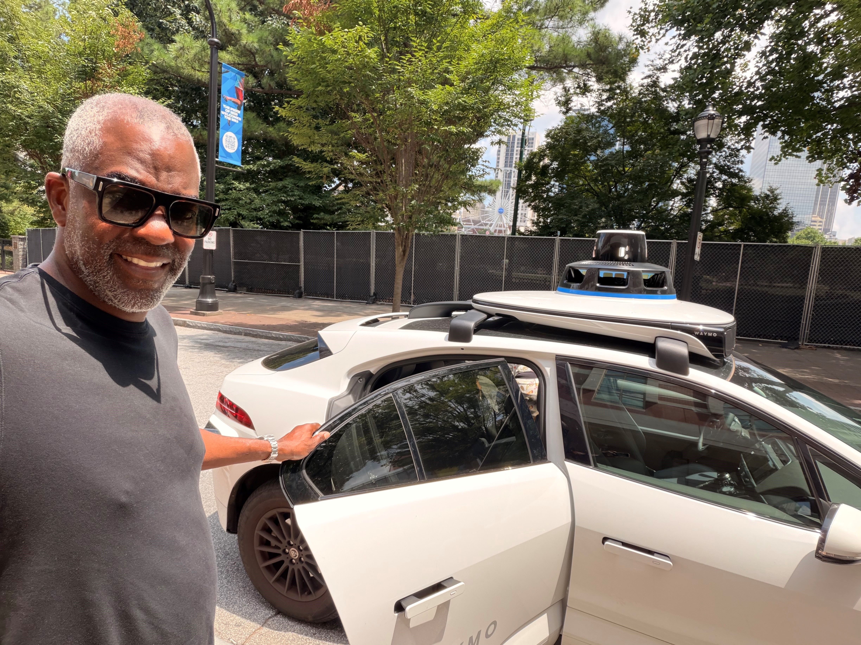

Slide 9
August 2026 — BBRC Calendar
TUE
AUG 4
Club Meeting — Exchange Student
TODAY
Caiden Miller• 7:30 AM • College Hall
TUE
AUG 11
Club Meeting — Computer Science Professor Kendal Martin
7:30 AM • College Hall
TUE
AUG 18
Club Meeting — Blue Bell Horizons Celebration Planning
Update from Angelo + event team breakouts • 7:30 AM • College Hall
TUE
JUL 28
Monthly Social— Bring a Friend!
Guests welcome!
16
Notes:
Walk through the month. Emphasize July 28 social at Porter — bring a friend! Great chance to introduce someone to Rotary in a relaxed setting.

Slide 10
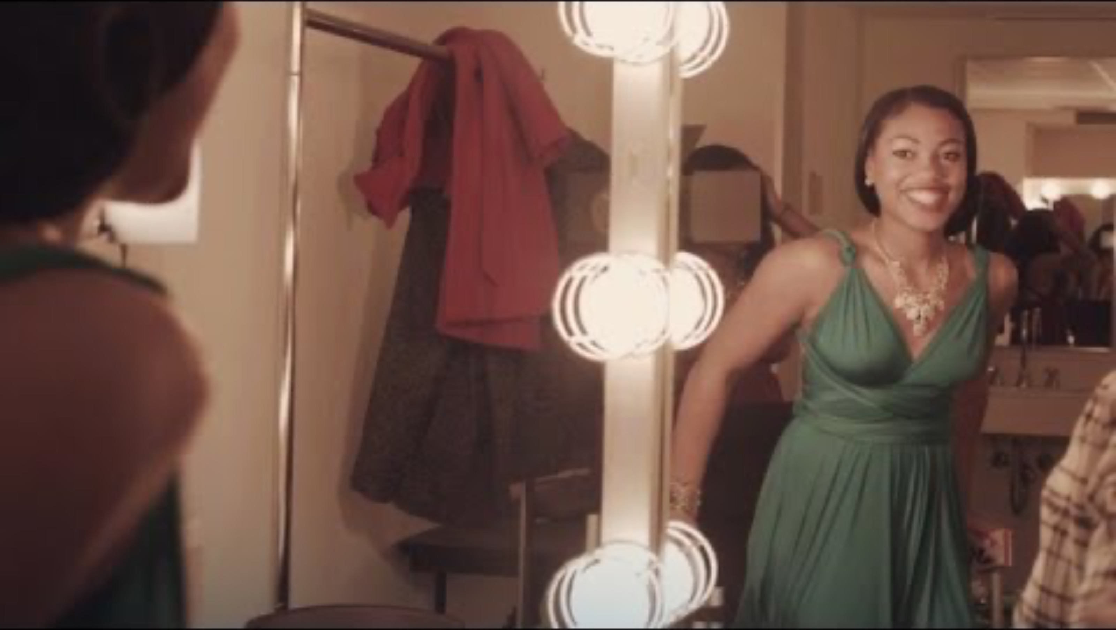
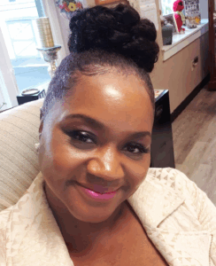
Today’s Program: Being Beautiful
Devon Lassiter,
Executive Director
18

